Slide 1
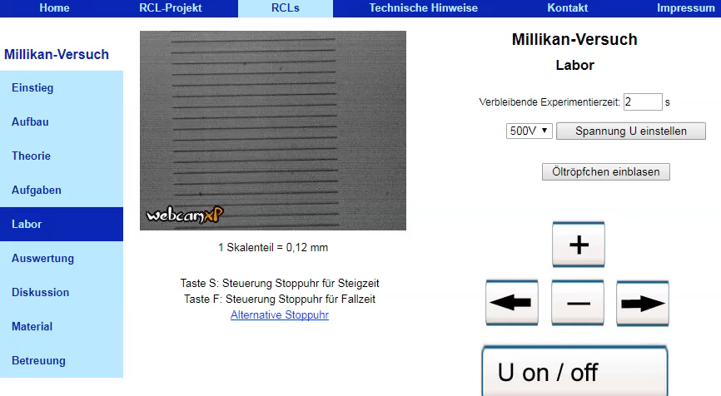
http://rcl-munich.informatik.unibw-muenchen.de/
Millikan’s Oil Drop experiment from Remotely Controlled Laboratories located in Germany. Incredible!

