Slide 1
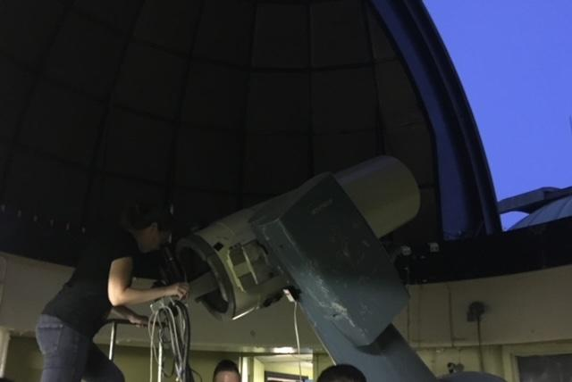
Modeling the Expanding Universe:
Ideas for Grade 9 Earth and Space Science
Understanding the expansion of the universe is a hard concept for students. This session focuses on an activity which incorporates luminosity, pulsation frequencies and red shift to share how scientists use these to explore the expansion of the universe.
Tasha Richardson, TDSB
Peter Luca, TCDSB
T. Richardson @ UofT, 2018
P. Luca @ OSC, 2022

Slide 2
Background Information for Teachers

Slide 3
Part A Background:
Relationship Luminosity & Pulsation
Why Do Some Stars Pulsate?
Some stars pulsate because of variations in the rate at which radiation escapes from the star. (Note: nuclear fusion in the core remains constant; so pulsation is not caused by radiation pressure from higher rates of fusion). Here are the steps involved in pulsating stars.
The outward pressure exceeds the inward pull of gravity Star expands outwards
Both outward pressure and inward pull of gravity decrease as star expands
Hydrostatic equilibrium occurs when gravity = pressure. But star keeps expanding at this point due to inertia
Eventually outer layer of star comes to a stop (because of gravity) and begins collapsing inwards
Now gravity and pressure both begin to increase, but pressure increases at a greater rate than gravity
The collapse slows down, and eventually stops
Process repeats, cycle begins again.
The pressure as a function of the star’s radius is given by:
Where:
𝝆 is the star’s density
G is the gravitational constant
R is the star’s radius at equilibrium

Slide 4
Part A Background:
Relationship Luminosity & Pulsation
Cepheids’ pulsation is the periodic expansion and contraction of the star, that we see as changes in brightness (From NASA GMS: Cepheid Variable in Spiral Galaxy). This happens as the gases within the cepheid build up and the pressure becomes larger than what the gravitational force can contain. The star periodically releases this pressure.
To find the relationship, we decided to do the math for the students and have them work with a linear graph.
Some terms
Absolute Magnitude: Brightness of a star measured at 10 parsecs.
Luminosity: This is a measure of the energy radiated by an object. It is an absolute measure of radiant power; that is, its value is independent of an observer's distance from an object
Step 1: Calculate Absolute Magnitude from the Period of Pulsation
Where P is the period of pulsation in days, M_{v} is the absolute magnitude if viewed 10 parsec away.
Step 2: Calculate Luminosity from Absolute Magnitude
Where L_{o} = 3.0128 x 10²⁸ W (or the luminosity of the Sun)

Slide 5
Part B Background:
Relationship Distance & Luminosity
The Sun has a brightness of about 1370 W/m². Sirius (a star located 8.611 ly away and a luminosity of about 25 times that of the sun) has an apparent brightness of 10⁻⁷ W/m². Distance greatly impacts how bright we see a star.
Different stars have different brightnesses; many stars have the same apparent brightness (undistinguishable to the untrained observer). For the sake of simplicity for this exercise for grade 9 students, we used the brightness of Sirius for all calculations with the assumption that all of the stars appear equally bright.
Some Terms
Brightness = the amount of power produced in a square metre; this is flux.
The relationship between distance and luminosity is given by the equation:
Where d is the distance in metres, L is luminosity in W, and b is the brightness W/m².
For our problem we used a brightness of 1.0 x 10⁻¹⁵ W/m². This was intentional to provide numbers easy for students to use.
We used queccawatts (10³⁰ W) to facilitate extracting information from the graph for students.

Slide 6
Part C Background:
Relationship Expansion & Redshift
Similar to the Doppler Effect discussed in Grade 11 physics, a redshift in astronomy means that the light that we see appears more red than when it was originally released.For a star that emits light at a specific frequency, if it is moving away from us, its emission lines - though still with equal spacing - will appear towards the red end of the spectrum. The more they are shifted right, the faster they are moving away from us.
In this exercise, we show that the farther away the cepheid is from Earth, the faster it is moving away. This means the universe is expanding.
The speed can be calculated using the relationship:
v=c(Δ𝛌/𝛌)
v is the speed of the cepheid measured in m/s, c is the speed of light (3.00 x 10⁸ m/s), Δλ is the change in the light in nanometres, and λ is the original light in nanometres.
Within this exercise we have made sure to preserve the Hubble Constant (73.8 km/s/Mpc) in our calculations. The Hubble Constant is the currently agreed upon rate of expansion of the universe.
v=H_{o}d
Note: a parsec is a unit of distance equal to ~3.26 light years (3.086 × 10¹³ kilometers). One parsec corresponds to the distance at which the mean radius of the earth's orbit subtends an angle of one second of arc (there are 3600 seconds of arc in 1 degree).
←Blue shift
→Red shift
Made with Spectroscopy Demonstrator

Slide 7
Part D Background:
The Expansion of the Universe
Graphing the recessional velocity versus the distance (in Mpc) will produce a linear relationship. The slope of this line will be the Hubble constant, currently determined to be 73.8 km/s/Mpc.
We have already done the conversion within this exercise. We used the following relationship:
1 pc = 3.26 ly = 3.086 x 10¹⁶ m
Interestingly, 1 parsec is the distance at which the mean radius of the earth's orbit subtends an angle of one second of arc (there are 3600 seconds of arc in 1 degree).
Obviously, there are more factors to consider, such as cosmic dust that contributes to an additional shift in what we see from cepheids.
Other methods include the use of Type Ia Supernovae.

Slide 8
Resources
In addition to our combined 45+ years of teaching physics, we have read, read, played, and read. We thank all of the people who supported this project!
Some resources we consulted in preparation of this resource…
Bradshaw, A. (2009). Cepheid Variables in M33 and the Extragalactic Distance Scale. Texas A&M University. http://oaktrust.library.tamu.edu/bitstream/handle/1969.1/ETD-TAMU-2009-05-808/Bradshaw_Approved_Thesis.pdf?sequence=2
Kirshner, R.P. (2002). The Extravagant Universe: Exploding Stars, Dark Energy, and the Accelerating Cosmos , Princeton U. Press, Princeton, N.J. ISBN 0-691-05862-8
Palma, C. (2017). Luminosity and Apparent Brightness. Lesson 4, Astronomy 801, Department of Astronomy and Astrophysics. The Pennsylvania State University. https://www.e-education.psu.edu/astro801/content/l4_p4.html
Pogge, R. (2006). Lecture 7: "Starlight, Starbright" Stellar Brightness. Astronomy 162, Ohio State University. https://www.astronomy.ohio-state.edu/pogge.1/Ast162/Unit1/bright.html#:~:text=Brightness%2DLuminosity%20Relationship%3A&text=At%20a%20particular%20Luminosity%2C%20the,the%20square%20of%20the%20distance.
Ryden, B. (2003). Pulsating Stars. Lecture 16, Astronomy 162, Ohio State University. https://www.astronomy.ohio-state.edu/ryden.1/ast162_4/notes16.html
Ryden, B. (2003). How bright is a star. Lecture 7, Astronomy 162, Ohio State University. https://www.astronomy.ohio-state.edu/ryden.1/ast162_2/notes7.html

